Slide 1
Camp Stanley Storage Activity Status Update
June 27, 2012

Slide 2
Introductions and Welcome

Slide 3
Emergency Evacuation & Restrooms

Slide 4
Agenda
Introduction
SWMU and AOC Updates
Groundwater Groundwater Monitoring Update CS-13
Treatability Study Updates SWMU B-3 AOC-65 SVE AOC-65 ISCO
Closure Path for EPA Order Site Visits SWMU B-3 Bioreactor Building CS-13
Adjourn

Slide 5
Status of Remaining Sites

Slide 6
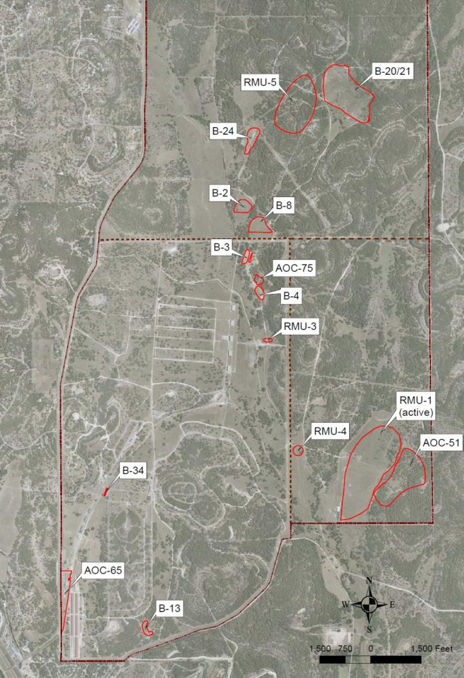
Site Closure Status
Recent TCEQ Closure Approvals: 4
RMU-2
AOC-72
AOC-74
WWTP
Field Efforts Complete or Nearly Complete
AOC-51
SWMU B-4
RMU-5
SWMU B-34 (APAR)
AOC-65 (IRA)
Field Efforts Remaining
SWMU B-13
AOC-75
RMU-3
RMU-4
Consolidated Sites with RMU-1 (Active Range)
SWMU B-2
SWMU B-8
SWMU B-20/21
SWMU B-24
Groundwater Sites
AOC-65
SWMU B-3

Slide 7
Field efforts Complete or nearly complete

Slide 8
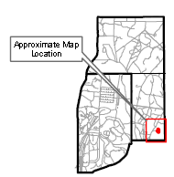
Site Closure Updates
AOC-51
Scattered ordnance debris site, 29.2 acres
Investigation efforts to date:
  XRF analysis, surface soil sampling, and UXO investigation
  Excavation of approximately 1,300 CY of contaminated soil, March 2012
  Calculated 95% Upper Confidence Limits (UCLs) per TAC 350.79(2)(A) for lead and zinc which do not exceed the Tier 1 PCLs.
Next steps:
  Submit RIR to TCEQ

Slide 9
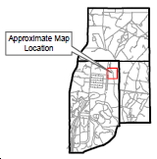
Site Closure Updates
SWMU B-4
Disposal area, 2 acres
Investigation efforts to date:
  Geophysical and soil gas surveys, soil sampling
  Excavation of 4 waste trenches (9,110 CY) by Weston, March 2011
  Discovered additional trench during surficial overage sorting, August 2011

Slide 10
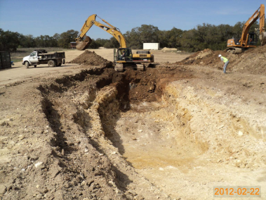
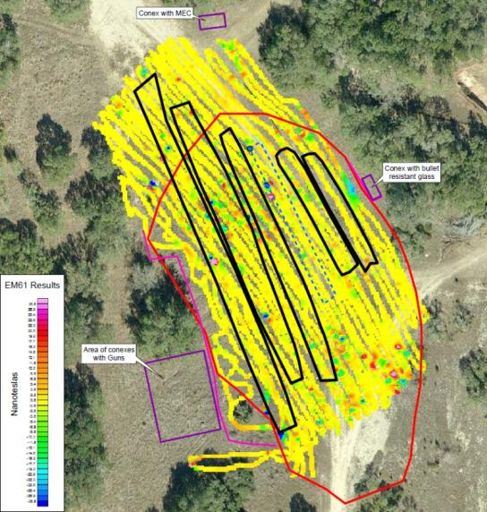
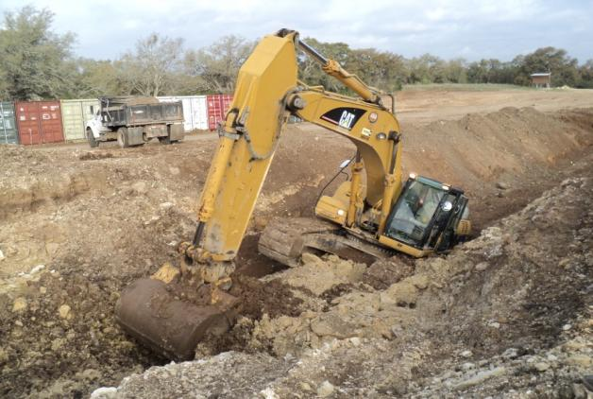
Site Closure Updates
SWMU B-4 (Cont.)
Investigation efforts to date, cont.:
  Excavated one additional trench, 15 ft x 200 ft x 16 ft (2,100 CY), March 2012.
Next steps:
  Weston to submit APAR.

Slide 11
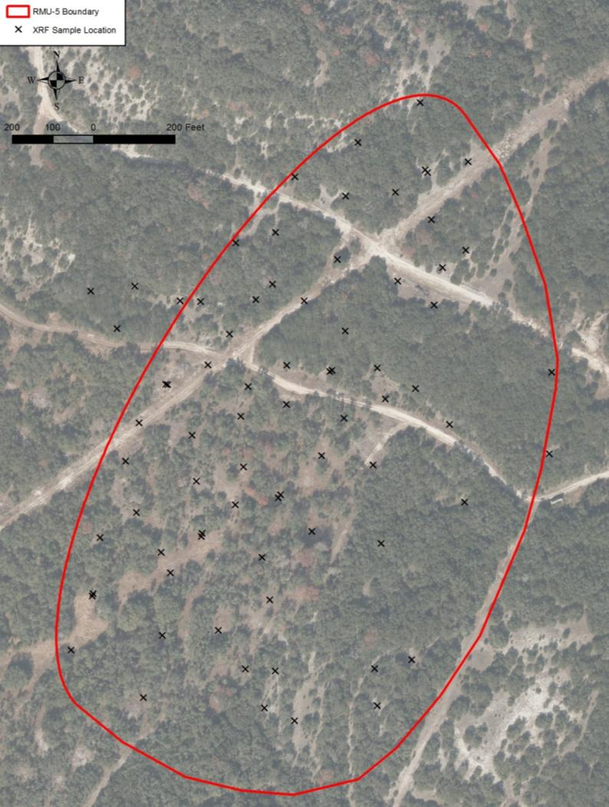
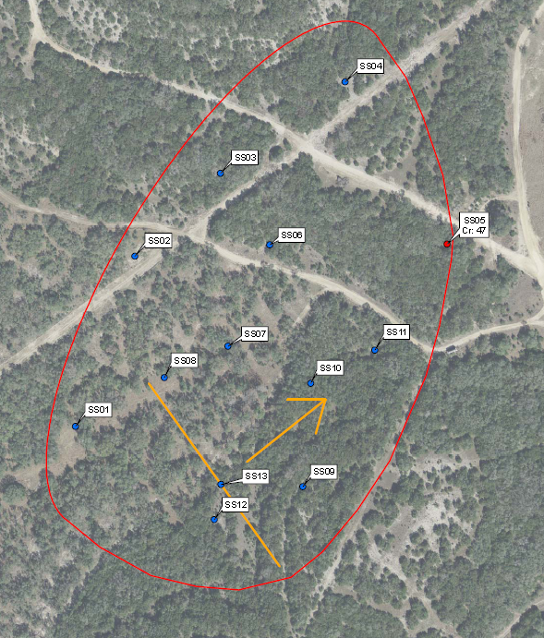

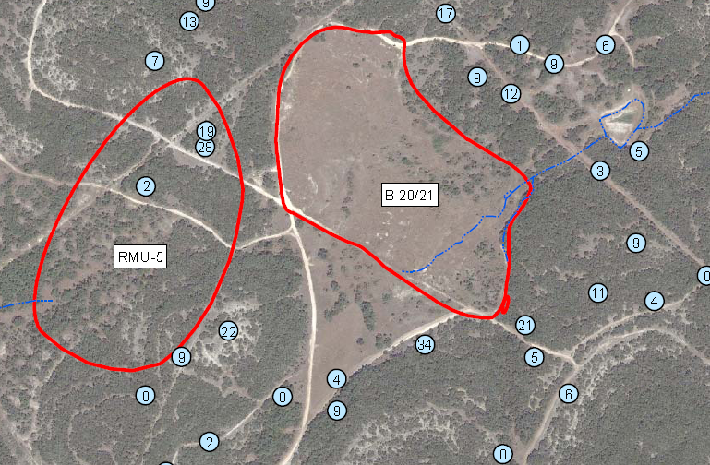
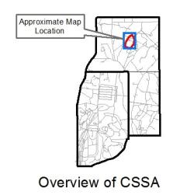
Site Closure Updates
RMU-5
Rocket range depicted on 1953 topographic map, 19.3 acres
Investigation efforts to date:
  XRF analysis and surface soil sampling
  Calculated 95% Upper Confidence Limits (UCLs) per TAC 350.79(2)(A) for chromium which does not exceed the Tier 1 PCL.
  Perimeter investigation of neighboring SWMU B-20/21: All MD indicative of kickout from SWMU B-20/21. North Pasture UXO investigation; no evidence of rocket range found
Next steps:
  Await RIR approval from TCEQ.

Slide 12
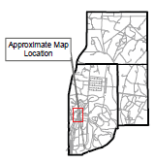
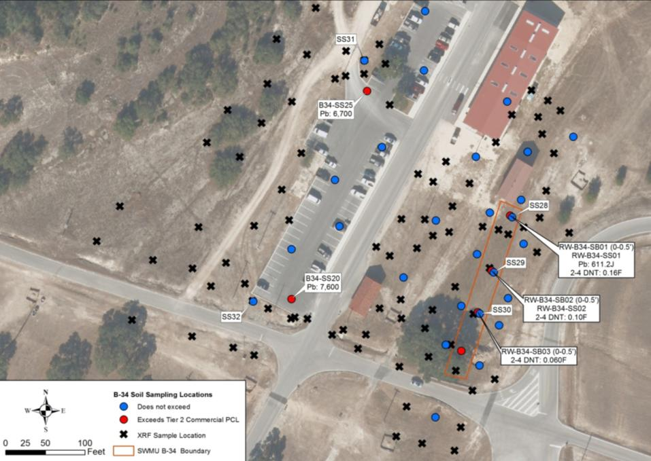
Site Closure Updates
SWMU B-34
Buried pipeline, 0.5 acres
Investigation efforts to date:
  geophysical survey, surface and subsurface sampling, and XRF analysis
  Additional XRF samples to the west of parking area, January 2012
Next steps:
  Resample surface soil at SB01 - SB03
  Submit APAR requesting NFA decision to TCEQ

Slide 13
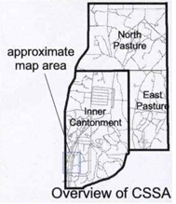
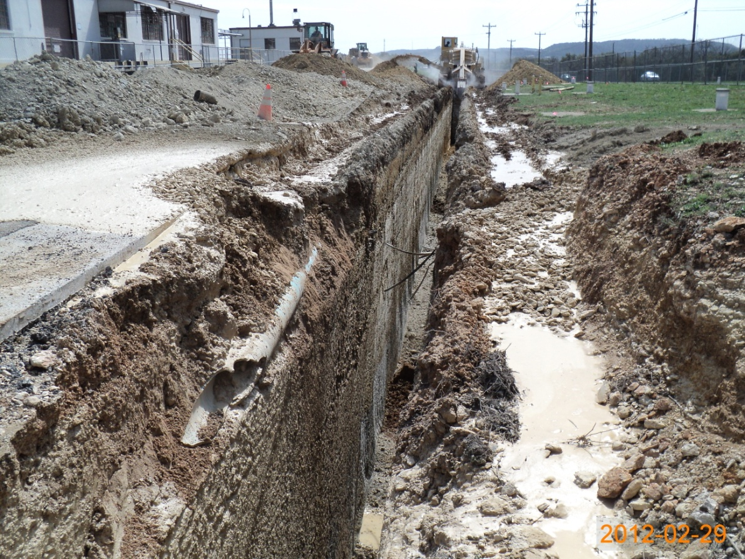
Site Closure Updates
AOC-65 (IRA)
  Interim Removal Actions (IRA) to date:
  Initial IRA in 2001 removed ~ 1,300 CY of contaminated soils from surface areas west of Bldg. 90.
  IRA in 2012 remove ~ 1,000 CY of contaminated limestone within the ditch area west of Bldg. 90. Trench measured ~ 310 ft x 3.5 ft x15 ft.
More detail provided in later slides

Slide 14
Field effortS Remaining

Slide 15
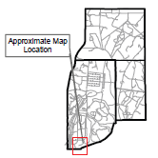
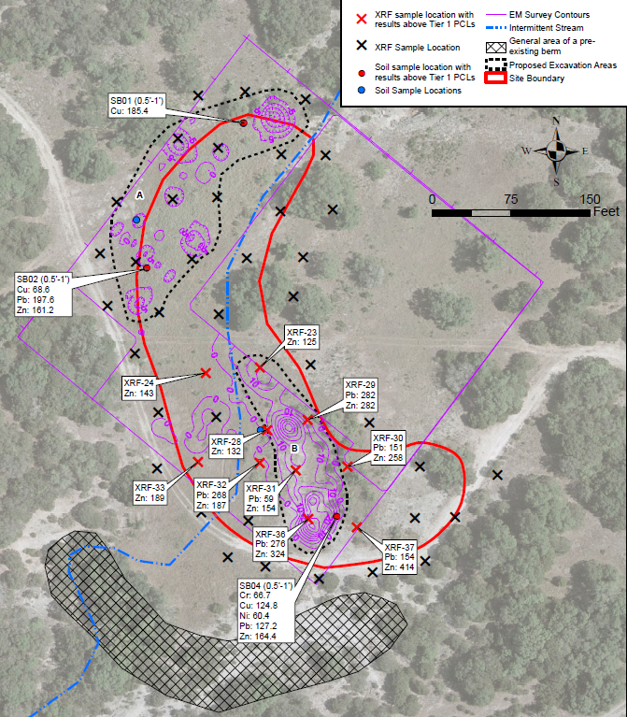
Site Closure Updates
SWMU B-13
Disposal area, 3 acres
COCs: chromium, copper, lead, nickel, and zinc
Investigation efforts to date:
  Geophysical survey, surface and subsurface soil sampling, XRF analysis
Next Steps (anticipate RIR closure in 2013):
  Excavate contaminated soil and waste materials
  Submit RIR requesting NFA decision to TCEQ.

Slide 16
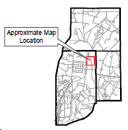
Site Closure Updates
AOC-75
Area with elevated mercury north of SWMU B-4, 1.2 acres
Originally part of SWMU B-4
COC: mercury
Investigation efforts to date:
  Surface and subsurface soil sampling
Next steps (anticipate RIR closure in 2013):
  Excavation of contaminated soil
  Submit RIR to TCEQ requesting NFA decision.

Slide 17
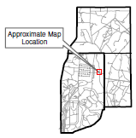
Site Closure Updates
RMU-3
Rifle range, 0.5 acre
COC: lead
Investigation efforts to date:
  XRF analysis, surface and subsurface soil sampling
Next Steps (anticipate RIR closure in 2013):
  Excavation of contaminated soil
  Submit RIR to TCEQ requesting NFA decision.

Slide 18
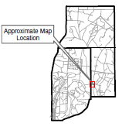
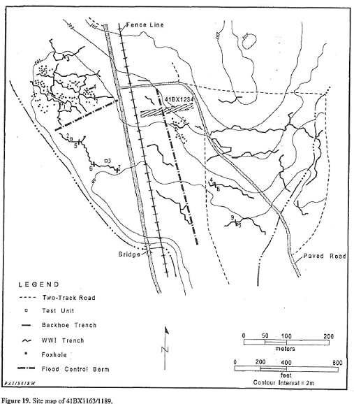
Site Closure Updates
RMU-4
Small arms range abutment, 1.6 acres
Concrete abutment (site 41BX1234) recommended to be considered ineligible for National Register nomination because integrity has been compromised (Phase I Archaeological Survey, April 1998)
WWI zig-zag trenches (41BX1163/41BX1189) recommended to be considered eligible.
RMU-4

Slide 19
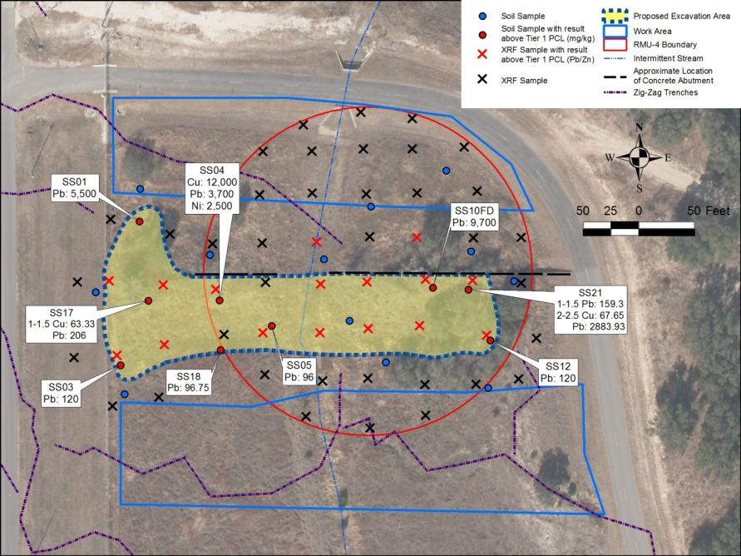
Site Closure Updates
RMU-4 (cont.)
COC: copper, lead, and nickel
Investigation efforts to date: XRF survey, soil sampling
Next steps (anticipate closure in 2013):
  Excavation of contaminated soil
  Submit RIR to TCEQ requesting NFA decision.

Slide 20
Groundwater Update

Slide 21
Groundwater Monitoring Program
Overview
Quarterly Monitoring Program:
  On-post since December 1999: 51 events
  Off-post since September 2001: 44 events
Wells included:
  45 On-post monitoring wells
  3 On-post drinking water supply wells
  2 On-post former drinking water wells
  4 Westbay®-equipped wells
  62 Off-post private and public supply wells (1 new well)
6 off-post wells have GAC units due to past exceedances
Notes:
21

Slide 22
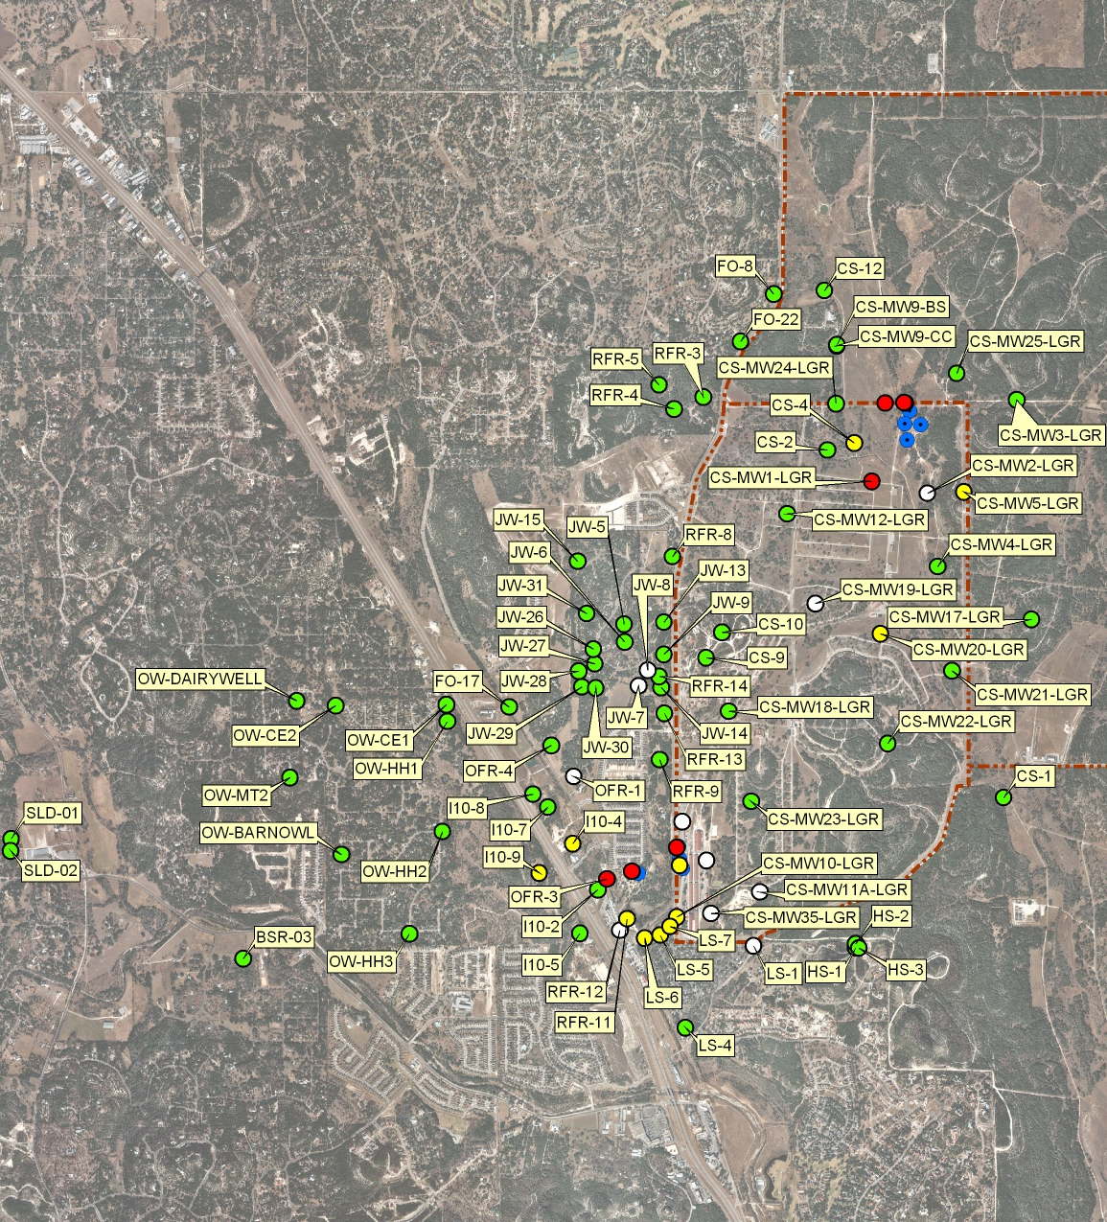
Groundwater Monitoring Program
Sampling Locations
11+ yrs of quarterly off-post monitoring.
13+ yrs of quarterly on-post monitoring.
Sampling locations vary quarterly per DQOs and LTMO.
Notes:
22

Slide 23
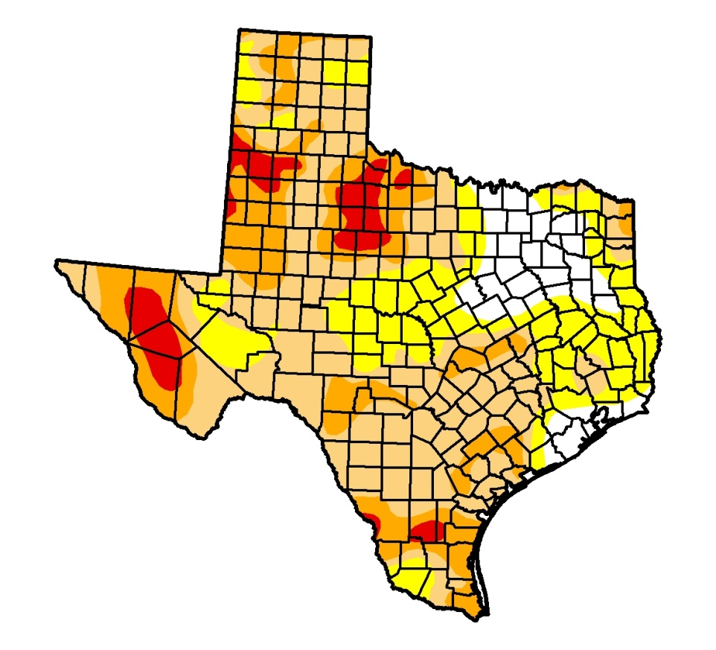
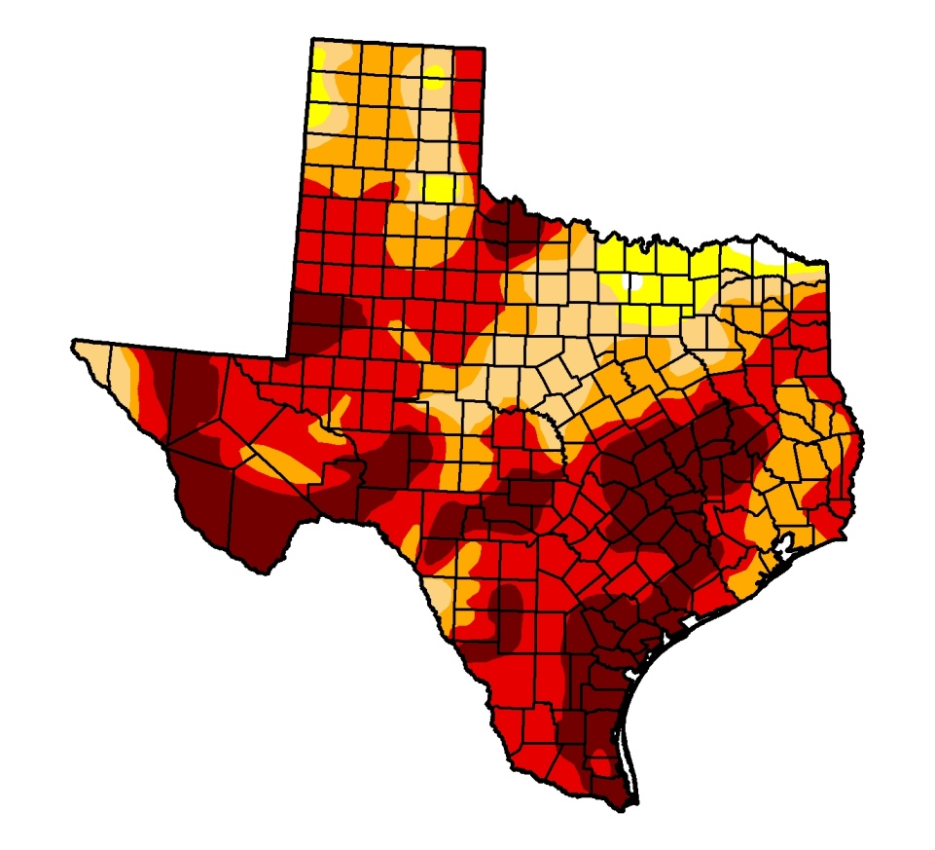
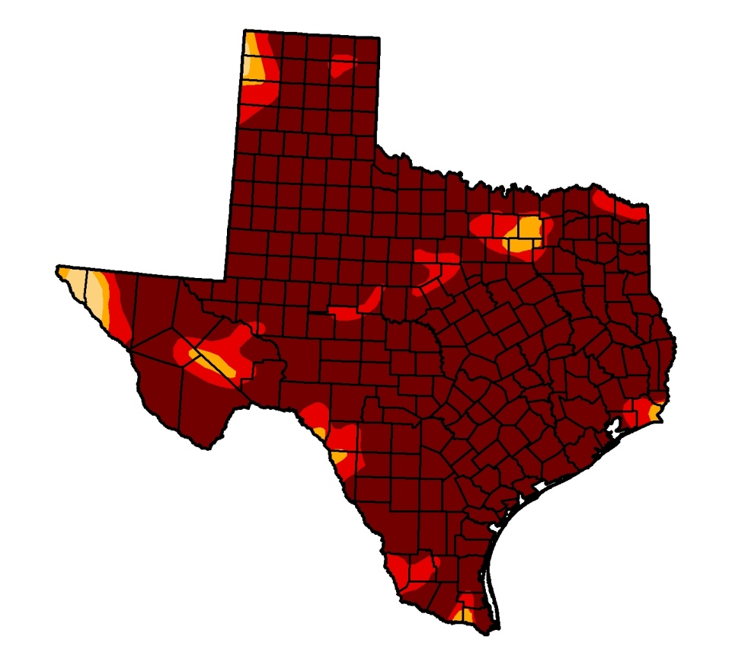
Groundwater Monitoring Program
Recent Changes
Central Texas was experiencing an “exceptional” drought until October 2011 when 12.3 inches occurred in the last 3 months of 2011.
Rainfall continued through May 2012, with CSSA receiving 13.97” in the first 5 months of the year, reducing drought stage to “moderate”.
Aquifer levels rebounded more than 66 feet by March, but have since declined ~ 45 feet by June. Aquifer level still “below average”.
Note that the average aquifer elevation “bottoms out” near the top of the LGR production zone during droughts.
June 12, 2012
June 19, 2012
January 24, 2012
October 4, 2011
Notes:
23

Slide 24
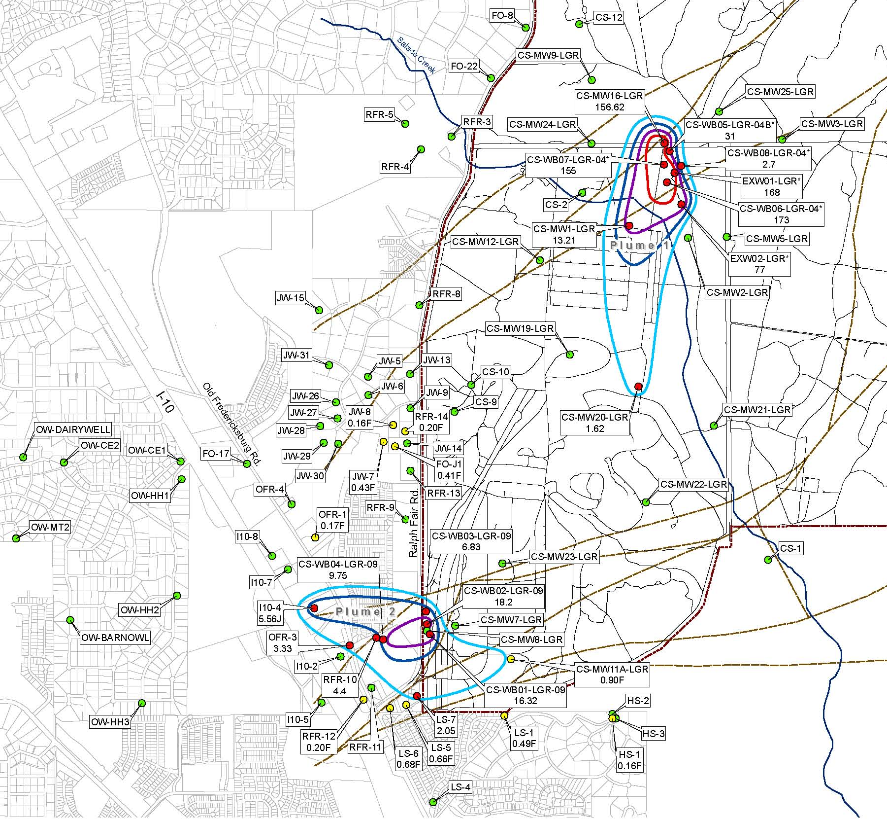
Groundwater Monitoring Program
General Facts
Plume 1 originates from SWMUs B-3 and O-1 in the Inner Cantonment.
Plume 2 originates from AOC-65 in the SW corner of CSSA.
Concern about increasing trend at I10-4 west of CSSA (Plume 2) prompted additional sampling locations west of IH-10 (12 new wells since March 2011).
The new DQOs and LTMO program (approved in 2010) went into effect in June 2011.
March 2012 was a “snapshot” event (all LGR and off-post wells sampled).
December 2012 will be the next snapshot event.
LEGEND
Area Above RL
Area Above MCL
PLUME 1
PLUME 2
June 2011 PCE
Notes:
24

Slide 25
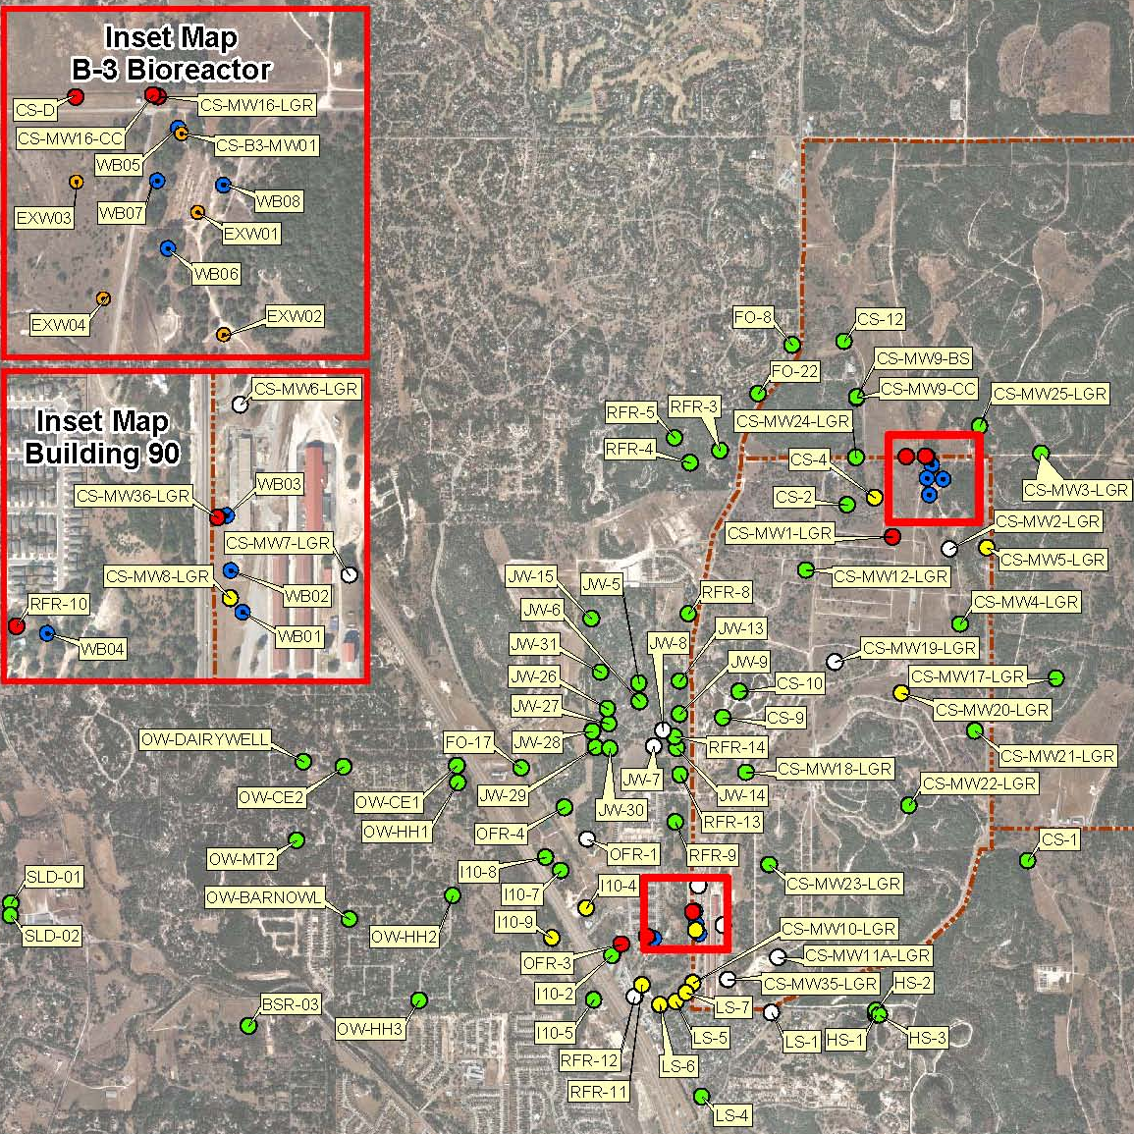
Groundwater Monitoring Program
March 2012 Results Overview
“Snapshot” event included 33 On-post and 55 Off-post wells. 1 On-Post well that was scheduled for sampling could not be sampled due to depressed water levels (water level below pump).
  New supply well CS-12 continues to be free of VOCs. All metals were below ALs, MCLs, SCLs.
  Five on-post wells continue to exceed the MCL for either PCE, TCE, or cis-1,2-DCE.
  On-post well CS-MW9-BS slightly exceeded the AL (0.015 mg/L) for lead with a concentration of 0.016 mg/L.
  Off-post well I10-9 was above the RL, but less than MCL for TCE for the third quarter in a row.
  A new well, BSR-03, was added to the program. No VOCs were detected in that well.
  Semi-annual GAC maintenance, including a carbon exchange, took place in January 2012. The next GAC maintenance, with carbon exchange, scheduled for July 2012.
Notes:
25

Slide 26
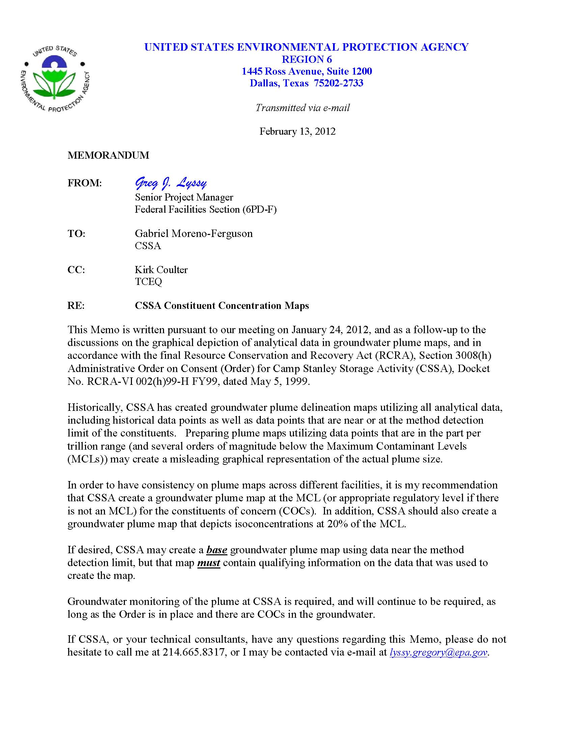
Groundwater Monitoring Program
Quality Assurance/Quality Control
In terms of usability, there are 3 levels that are considered in evaluating the groundwater condition:
  Quantitative: Data above the RL (sometimes referred to the as the PQL). For CSSA COCs, the RL is typically well below established regulatory limits. Using PCE as an example, the MCL is 5 µg/L, but the CSSA RL is 1.4 µg/L.
  Qualitative/Trace: Detections are F-flagged results that are positively identified but are considered “qualitative” data below the quantitation limit (RL) and the MDL.
  “Non Detects” (U-Flags) are below the MDL and therefore considered not present in the sample.
In February 2012, the EPA issued CSSA a memorandum requesting that they stop using “trace” detections (F-flags) in representing the extents of the groundwater plume.
Notes:
26

Slide 27
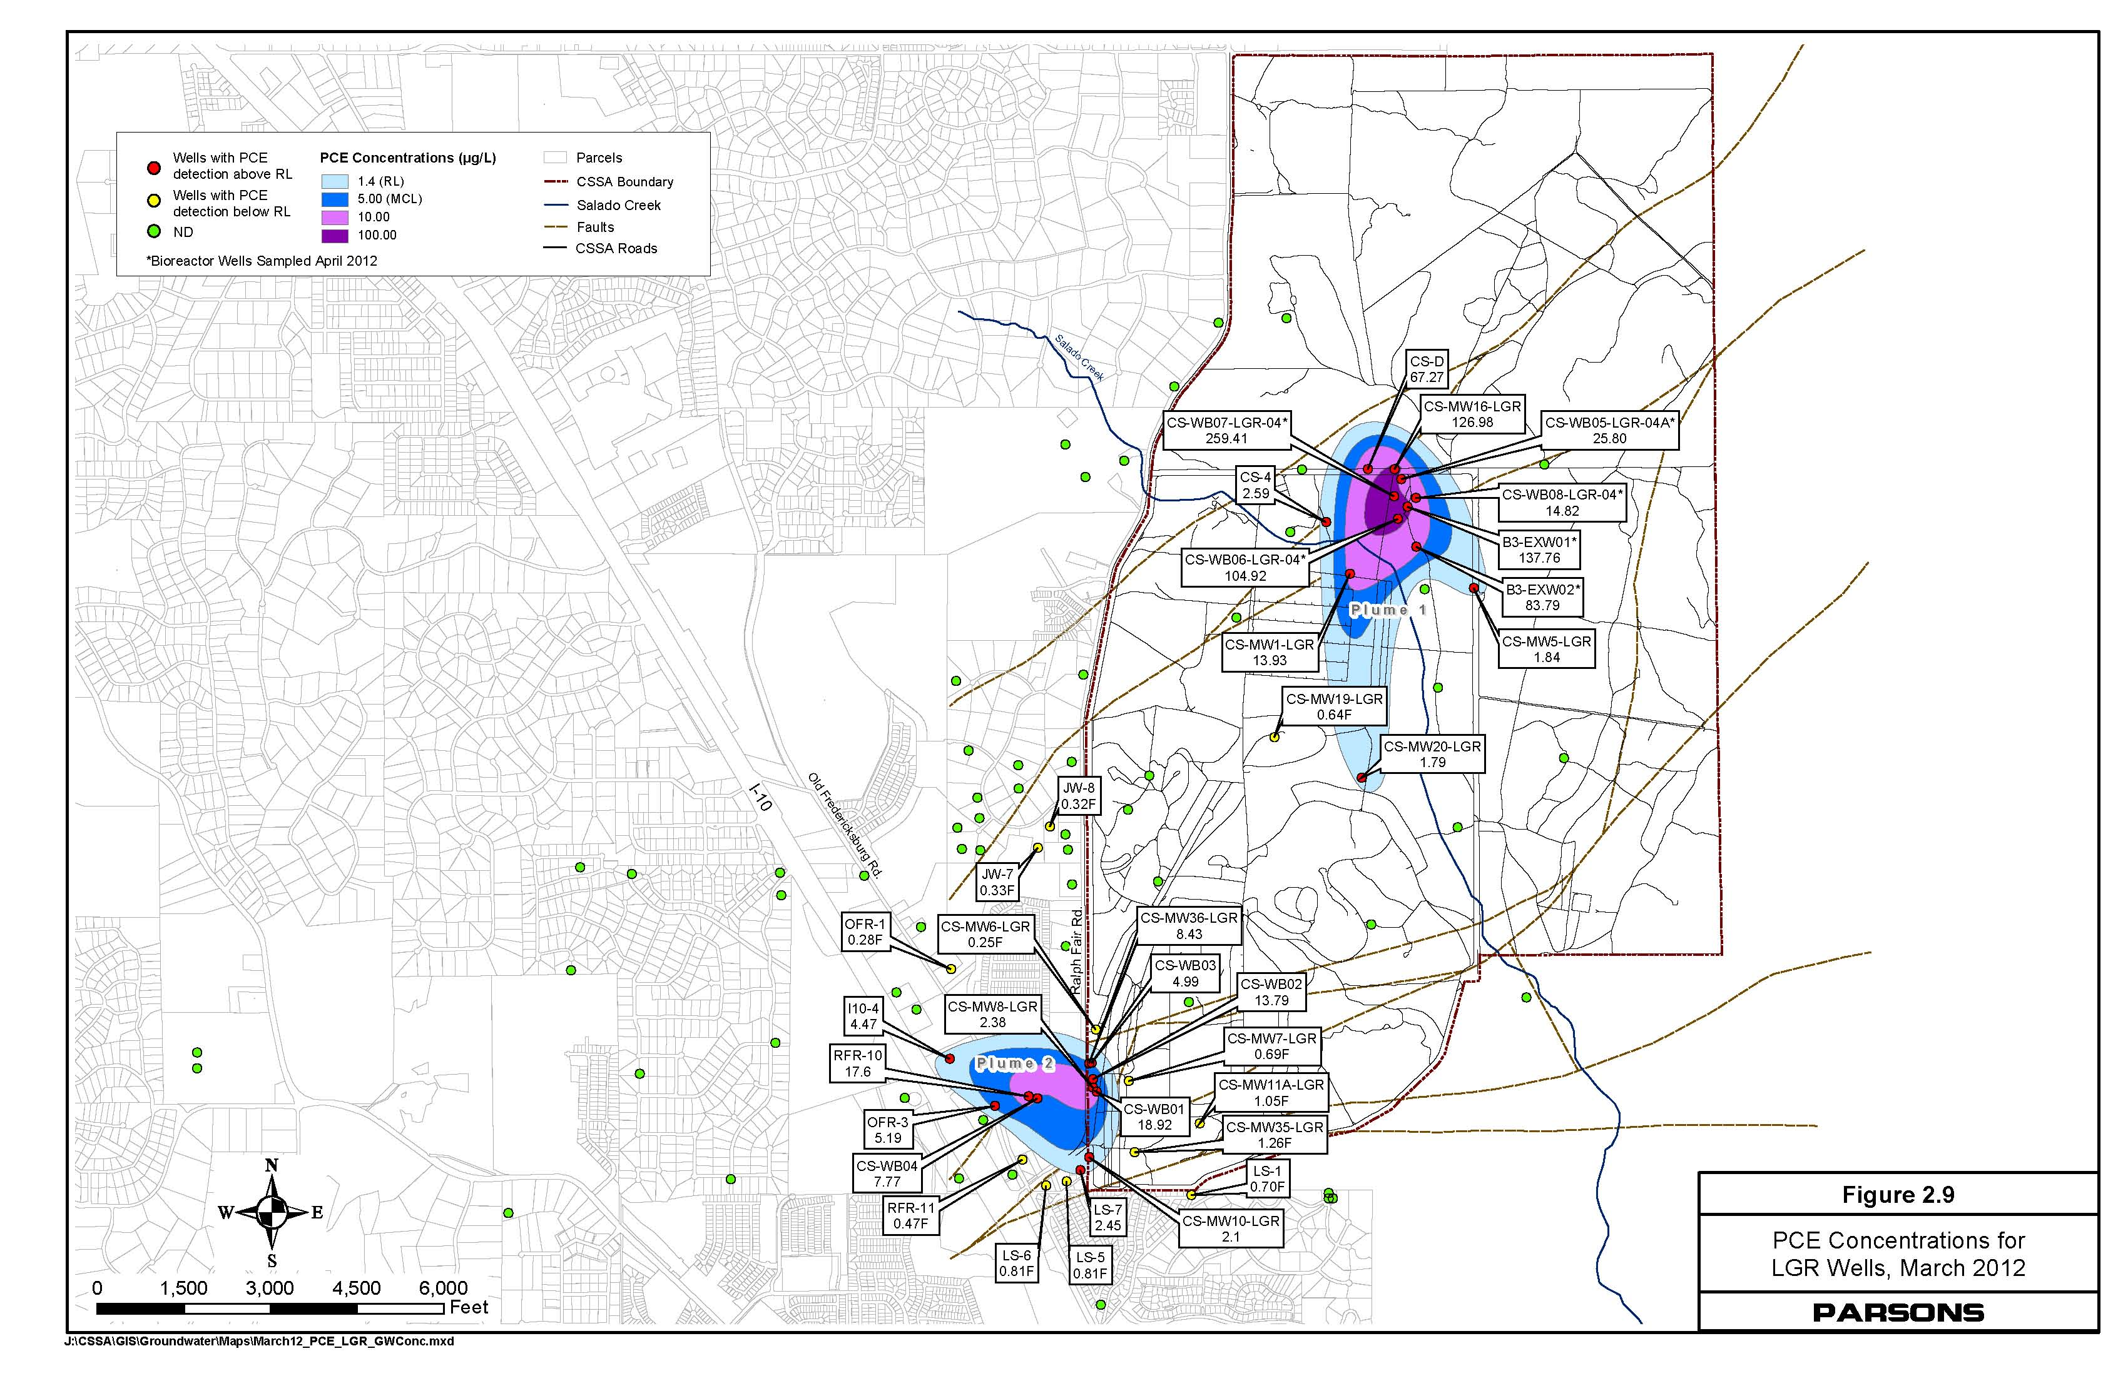
Groundwater Monitoring Program
March 2012 PCE
PLUME 1
PLUME 2
Notes:
27

Slide 28
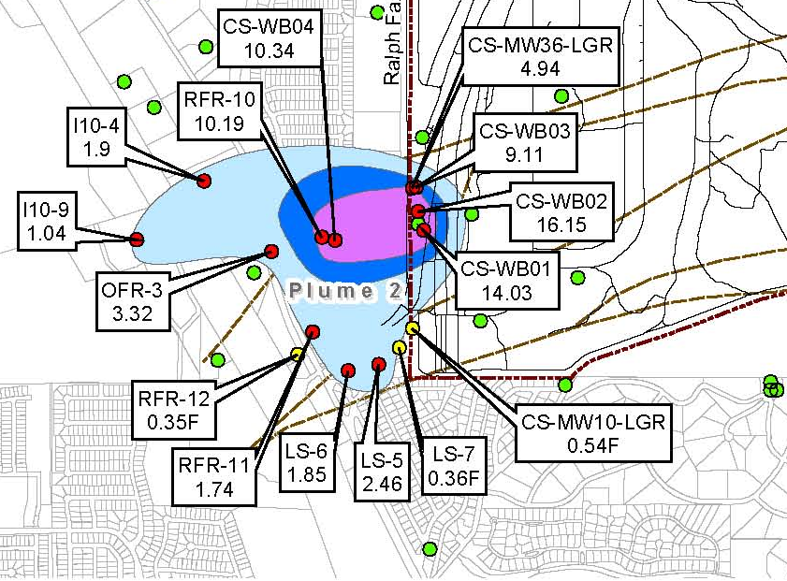
Groundwater
Monitoring Program
Plume 2 Results
PCE has not been reported west of Interstate Highway 10 since its initial trace detection in March 2011
TCE has been reported west of Interstate Highway 10 at well I10-9 since September 2011
  September 2011: 0.57F µg/L
  December 2011: 1.29 µg/L
  March 2012: 1.04 µg/L
March 2012 PCE
March 2012 TCE
Notes:
28

Slide 29
Groundwater Monitoring Program
June 2012 Overview
In accordance with the LTMO schedule, 17 samples were collected between June 4-14, 2012.
  11 Off-post wells
  6 On-post wells
  Validated results will be available in mid-July.
Notes:
29

Slide 30
Supply Well CS-1
Detections of Lead
  Samples collected in September 2011 indicated Lead above the AL at 0.0294 mg/L. A November 2011 re-sample at 0.0214 mg/L confirmed the result.
  The subsequent quarterly event in December 2011 was below the AL at 0.0073F mg/L.
  March 2012 sampling resulted in a “Non-Detect” for lead.
  Trend may indicate that lead is temporarily present in the well after significant recharge events.
Notes:
30

Slide 31
Supply Well CS-1
Trends???
No sample collected after recharge event
Notes:
31

Slide 32
Treatability Study Updates

Slide 33
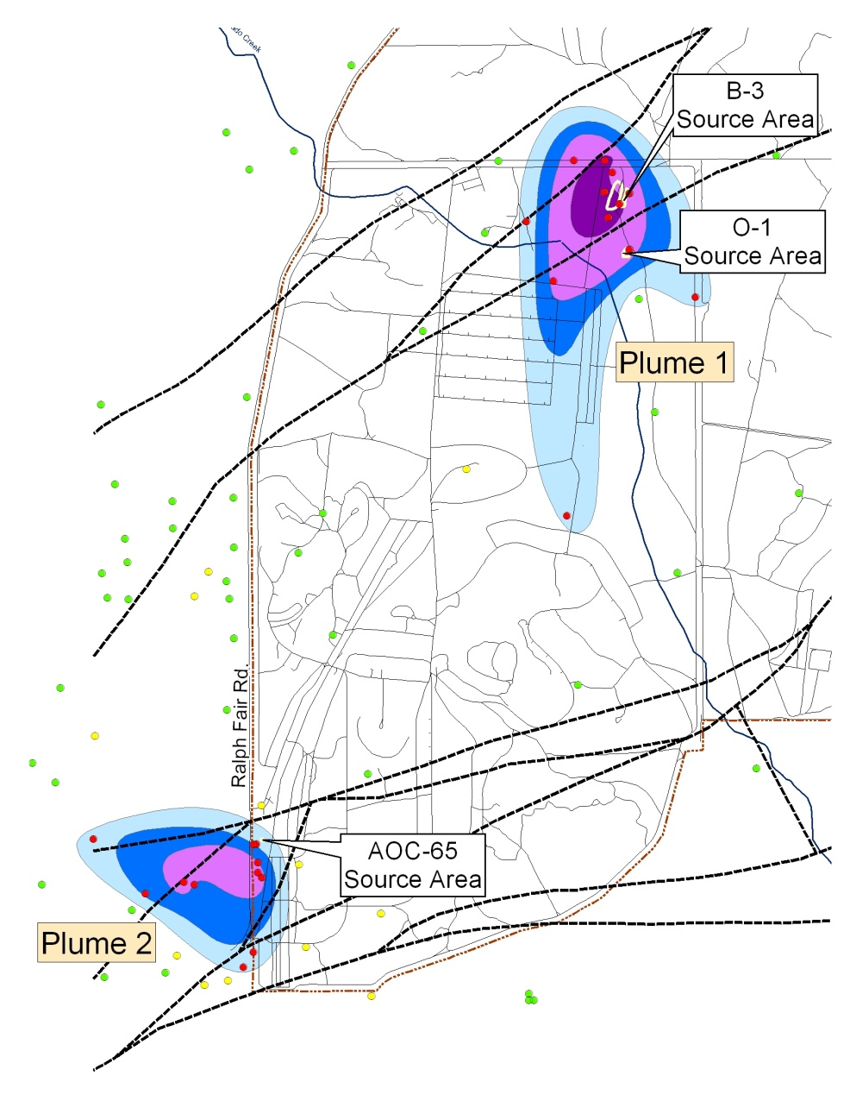
SWMU B-3 and AOC-65
Description
SWMU B-3 Bioreactor:
Enhanced anaerobic bioremediation of chlorinated hydrocarbons in underlying fractured limestone at Plume 1.
AOC-65 Soil Vapor Extraction and Interim Removal Action:
Removal of chlorinated hydrocarbons in underlying fractured limestone at Plume 2.
PCE, March 2012

Slide 34
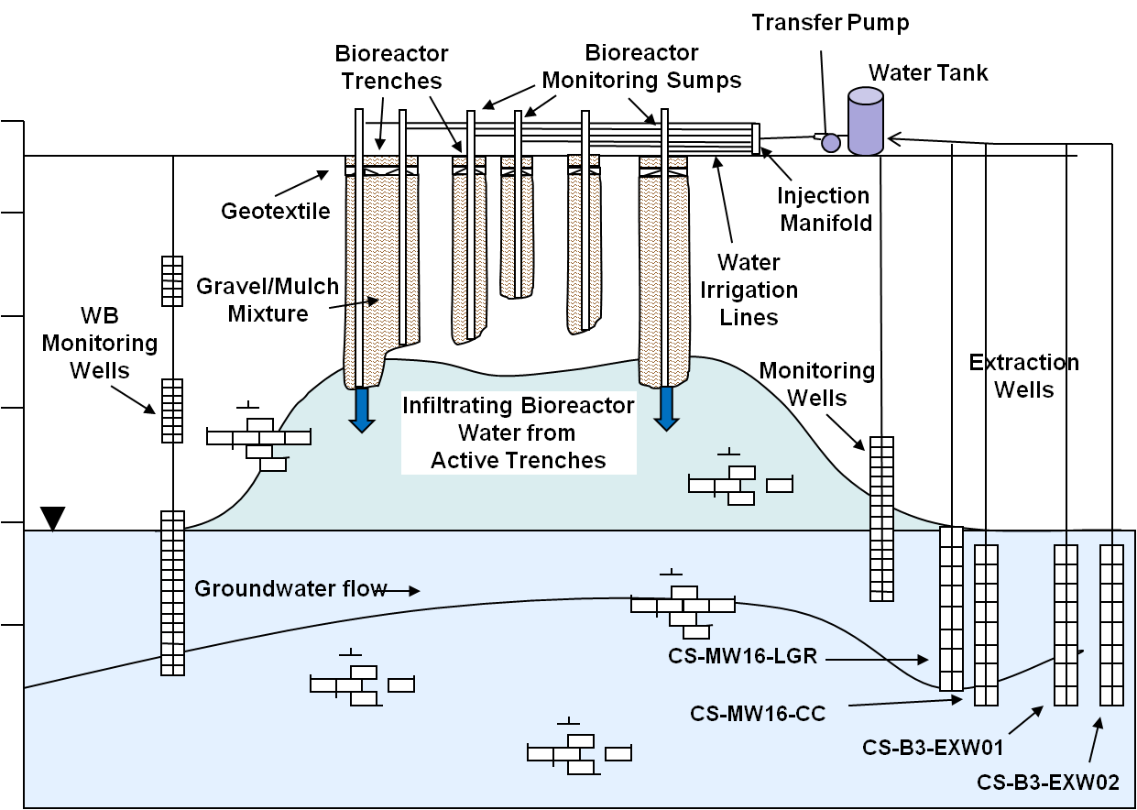
B-3 Bioreactor
General Observations
      Bioreactor is effectively treating approximately 20,000 gallons and 25,000 gallons of injected contaminated groundwater per day in Trenches 1 and 6, respectively.
      Biotic degradation is occurring with biological degradation end products ethylene, ethane, and CO₂ identified in surrounding UGR wells and LGR wells.
      Significant contamination likely remains in the fractured bedrock formation. Underlying VOC’s are being mobilized.
Bioreactor Conceptual Diagram

Slide 35
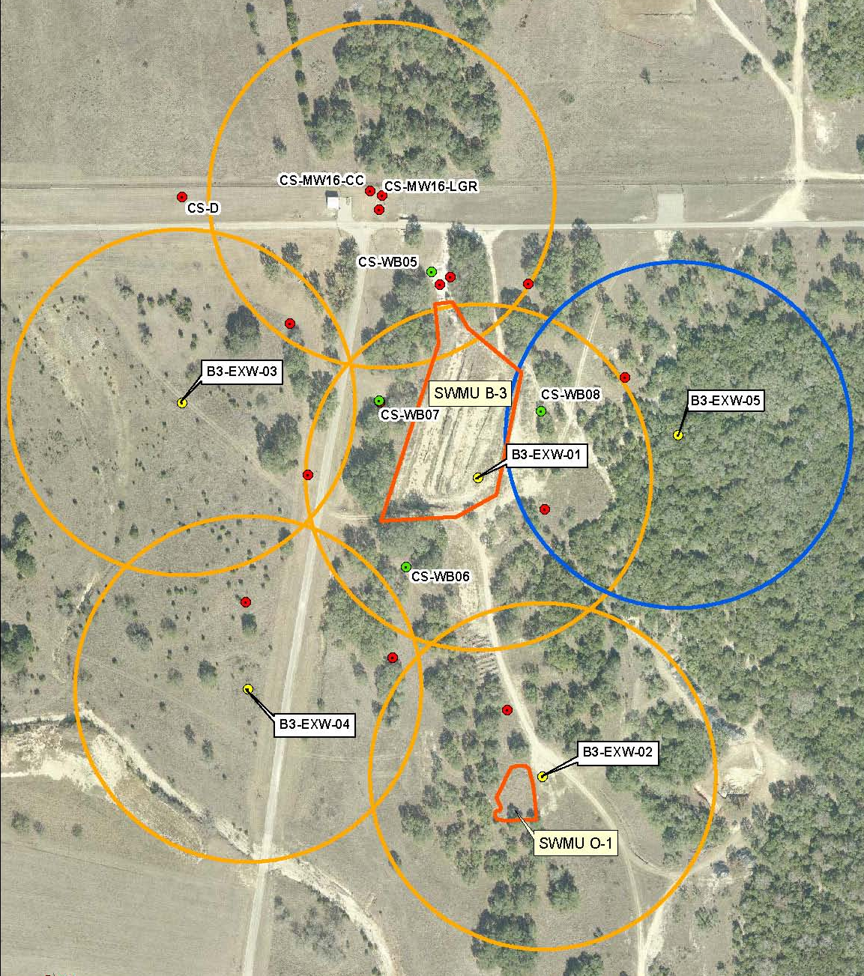
Recent Bioreactor Activities
A request was made by the EPA to improve the monitoring network east of SWMU B-3 to ensure plume delineation.
The addition of a new extraction well (EXW-05) provides an additional monitoring point and expands the recovery (extraction) area within the LGR.
Once connected to the system, EXW-05 will provide additional contaminant mass.
  Preliminary data from drilling indicate:
    PCE – 11.76 µg/L
    TCE – 43.16 µg/L
    cis-DCE – 23.92 µg/L

Slide 36
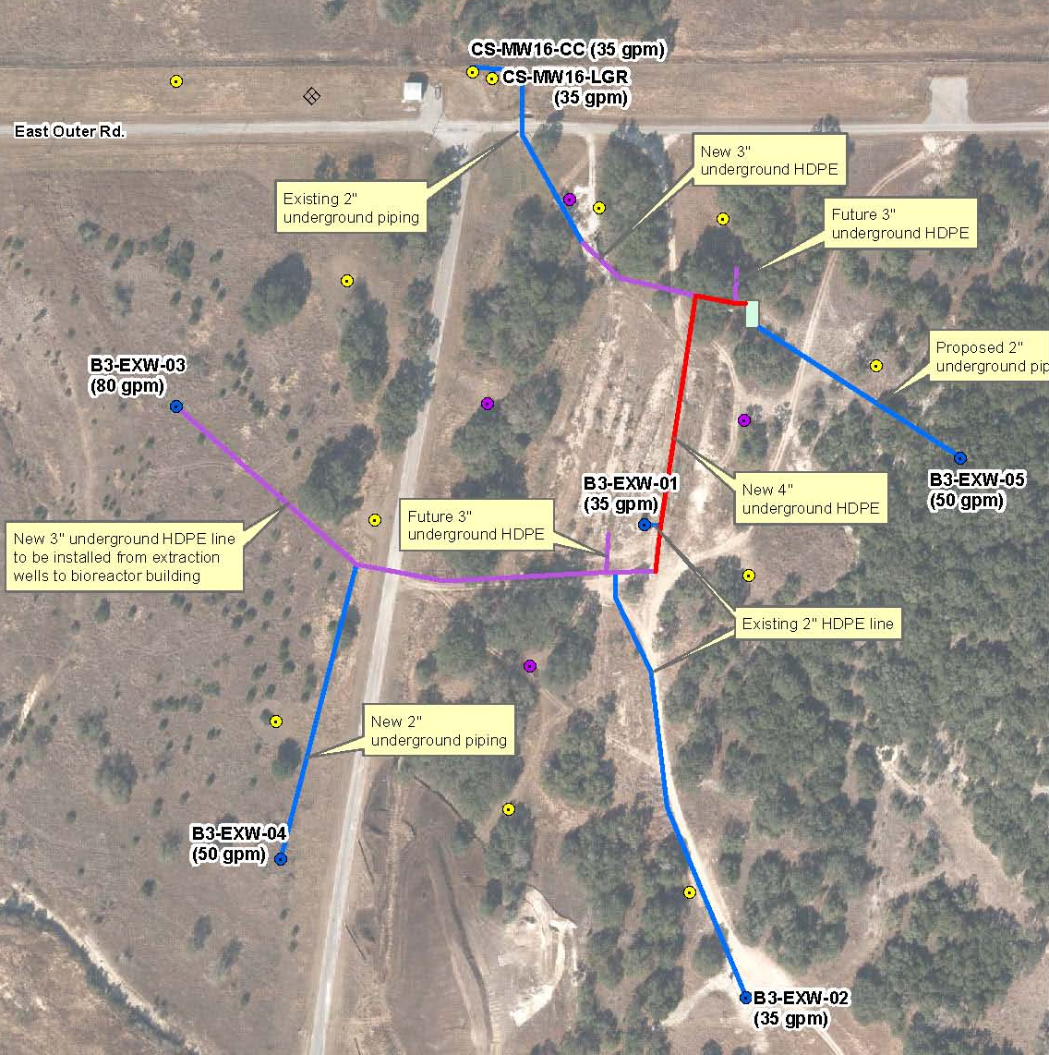
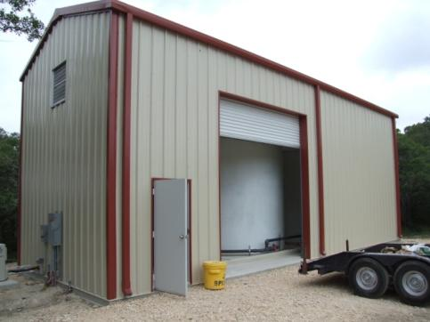
Recent Bioreactor Activities (cont.)
      The bioreactor control building has been completed and awaits SCADA control.
      Trenches 1, 2 and 6 have been recharged with mulch, gravel and new injection lines.

Slide 37
B-3 Bioreactor
Current Sampling Efforts
      Regulatory Sampling
      VOCs
      TDS
      pH at injection site (field)
      Performance Sampling
      MEE + CO₂
      Ferrous Iron
      Manganese
      Arsenic
      Total Organic Carbon
      Dissolved Organic Carbon
      Sulfide
      Sulfate and Chloride
      Dehalococcoides
      Dissolved Hydrogen
      Regulatory Sampling Locations
      Injection Manifold (UIC) - Quarterly
      Trench Sumps - Semi-Annual
      WB-03B Zones - Semi-Annual
      Performance Sampling Locations
      Frequency: Semi-Annual
      Trench Sumps (5)
      WB zones (27)
      Extraction Wells (6)
      LGR Monitoring Wells (4)
      UGR Monitoring Wells (9)
      Field Parameters Collected
pH
DO
Conductivity
ORP
Temp
Water Level

Slide 38
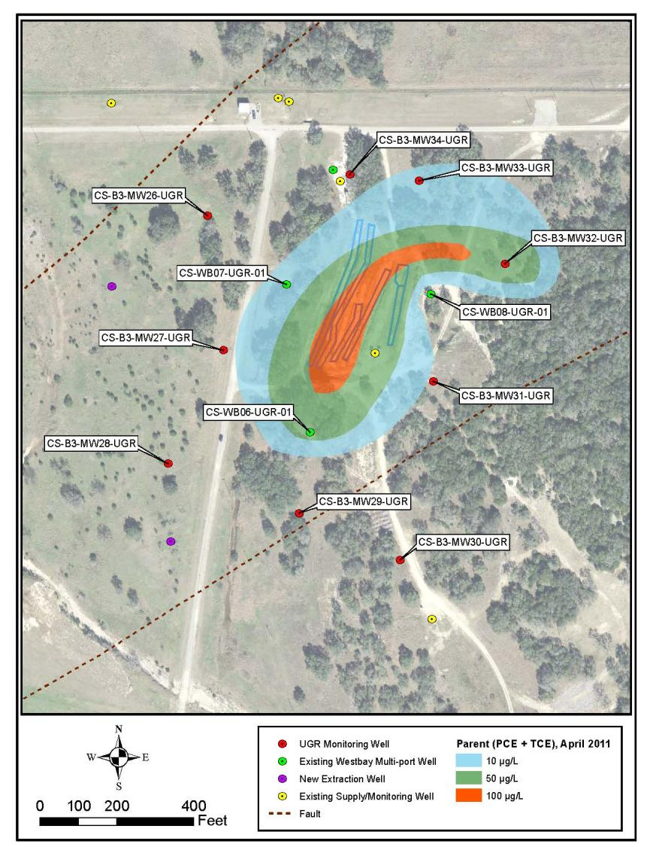
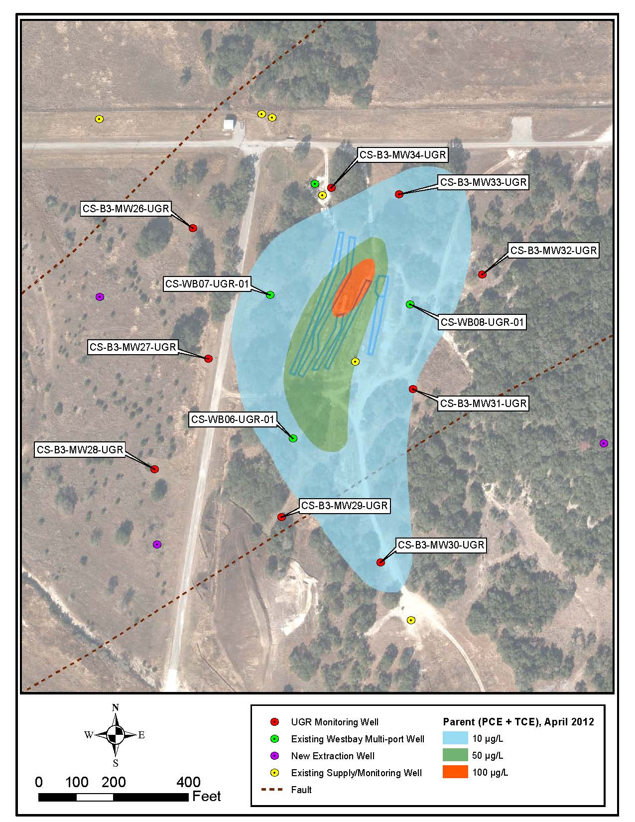
B-3 Bioreactor
UGR Observations – PCE and TCE
      PCE and TCE concentrations appear to remain stable within the bioreactor footprint.
April 2011
April 2012

Slide 39
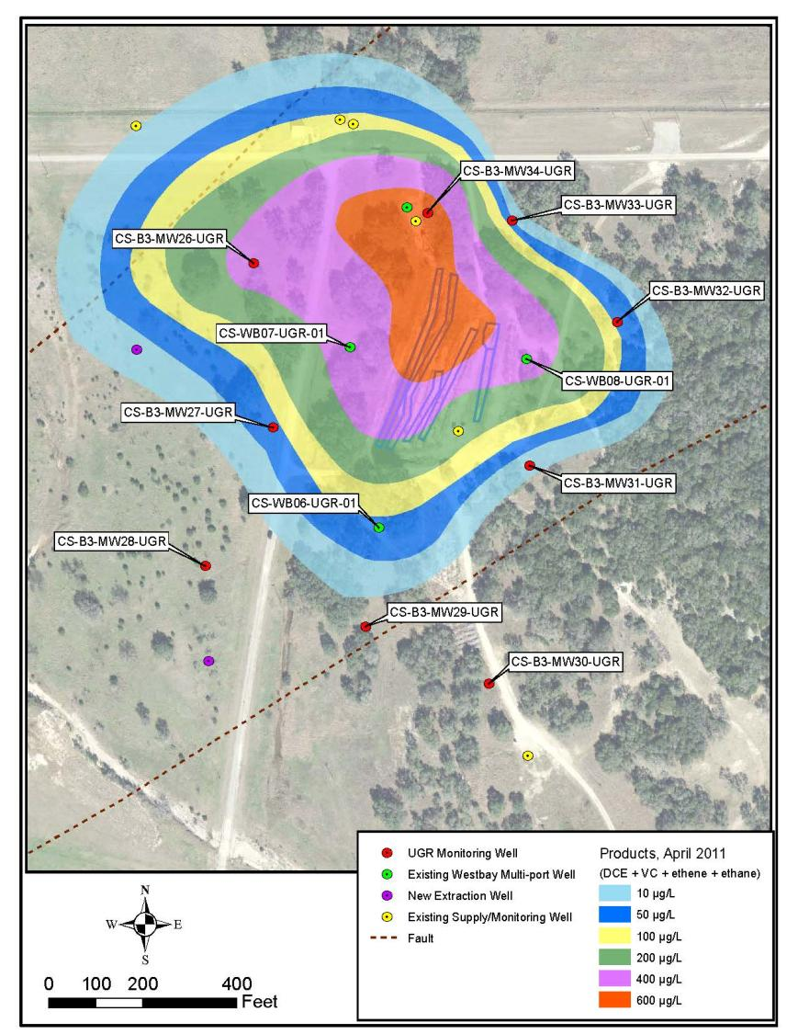
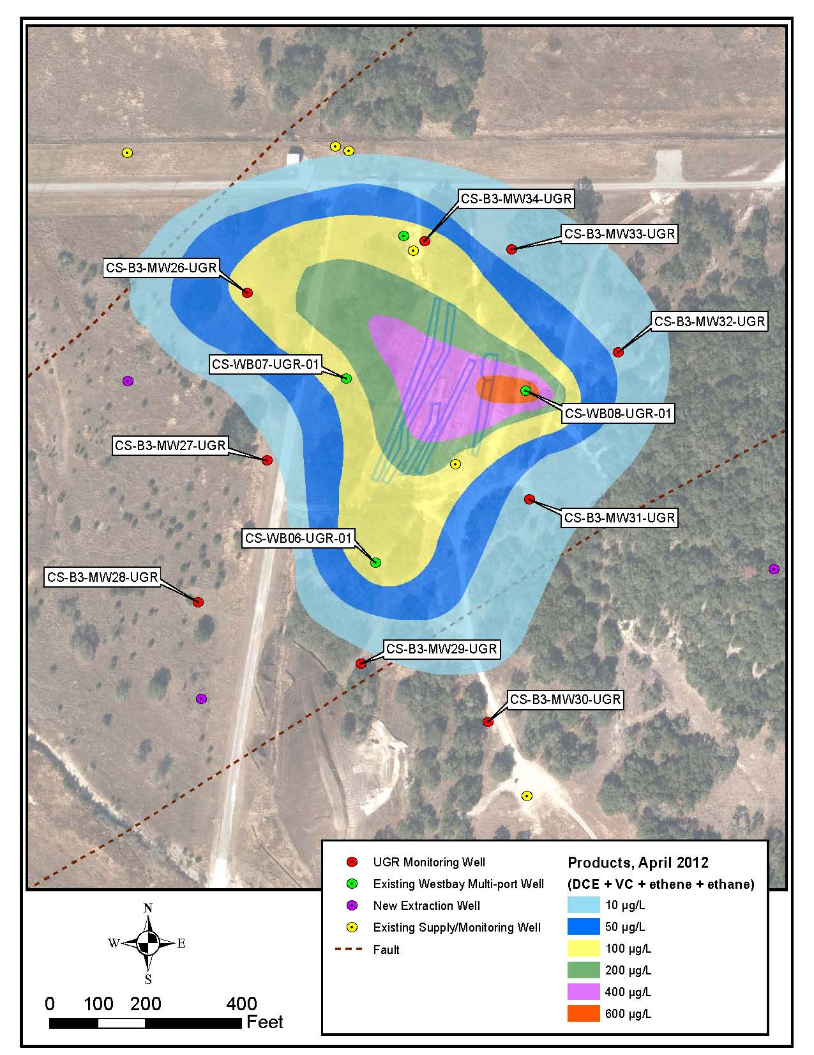
B-3 Bioreactor
UGR Observations – Dechlorination Products
      Widespread presence of degradation products shows bioreactor influence.
April 2011
April 2012

Slide 40
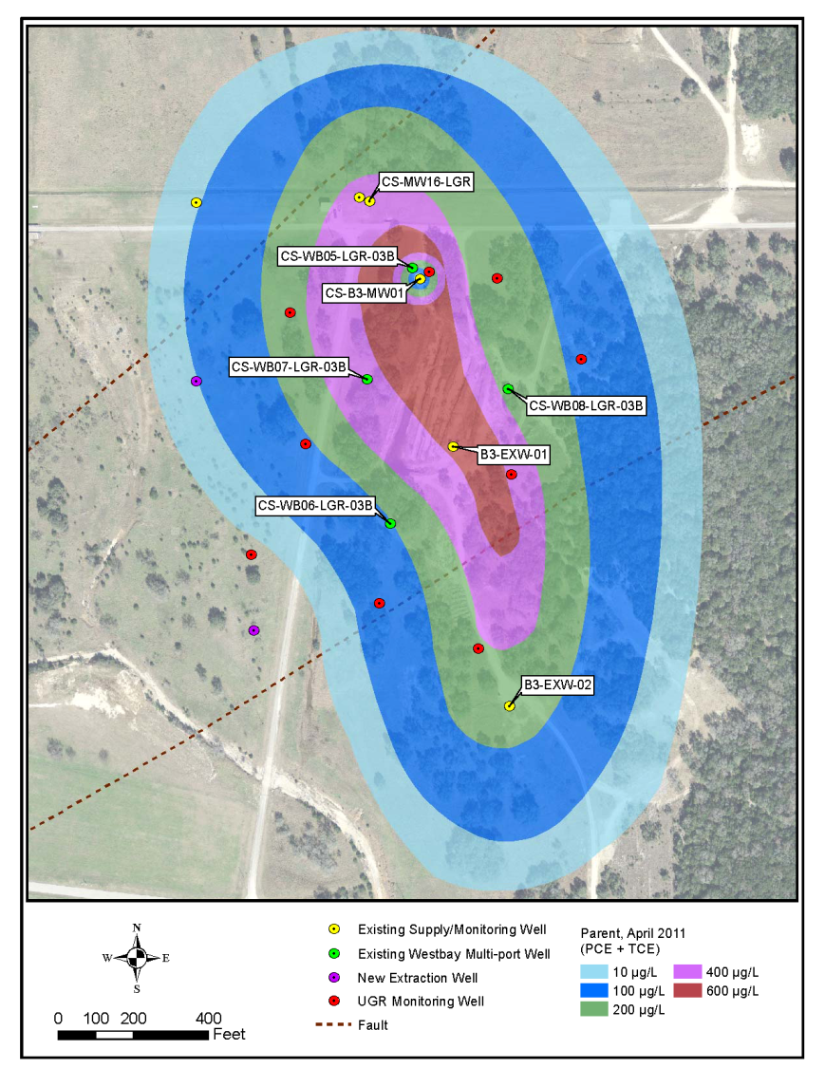
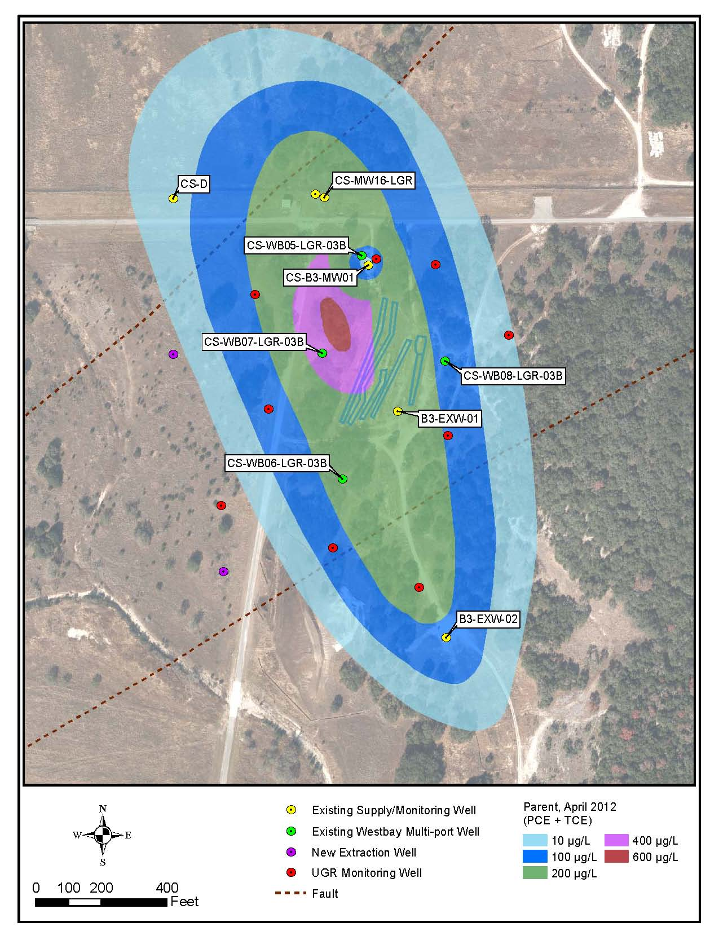
B-3 Bioreactor
LGR Observations –
PCE and TCE
      Lack of PCE and TCE in the vicinity of CS-B3-MW01 reflect degradation associated with lactate injection in 2006.
April 2011
April 2012

Slide 41
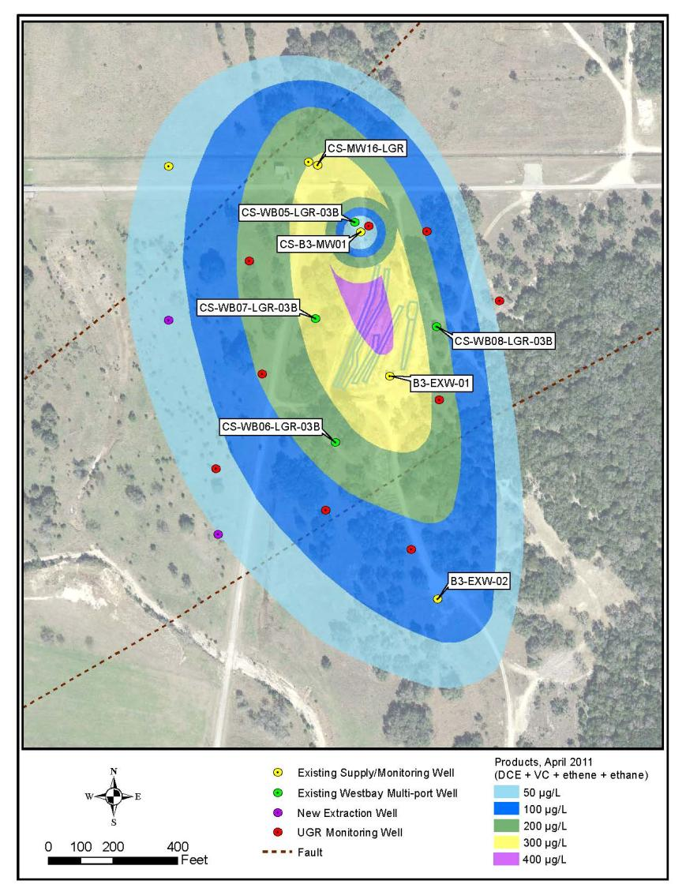
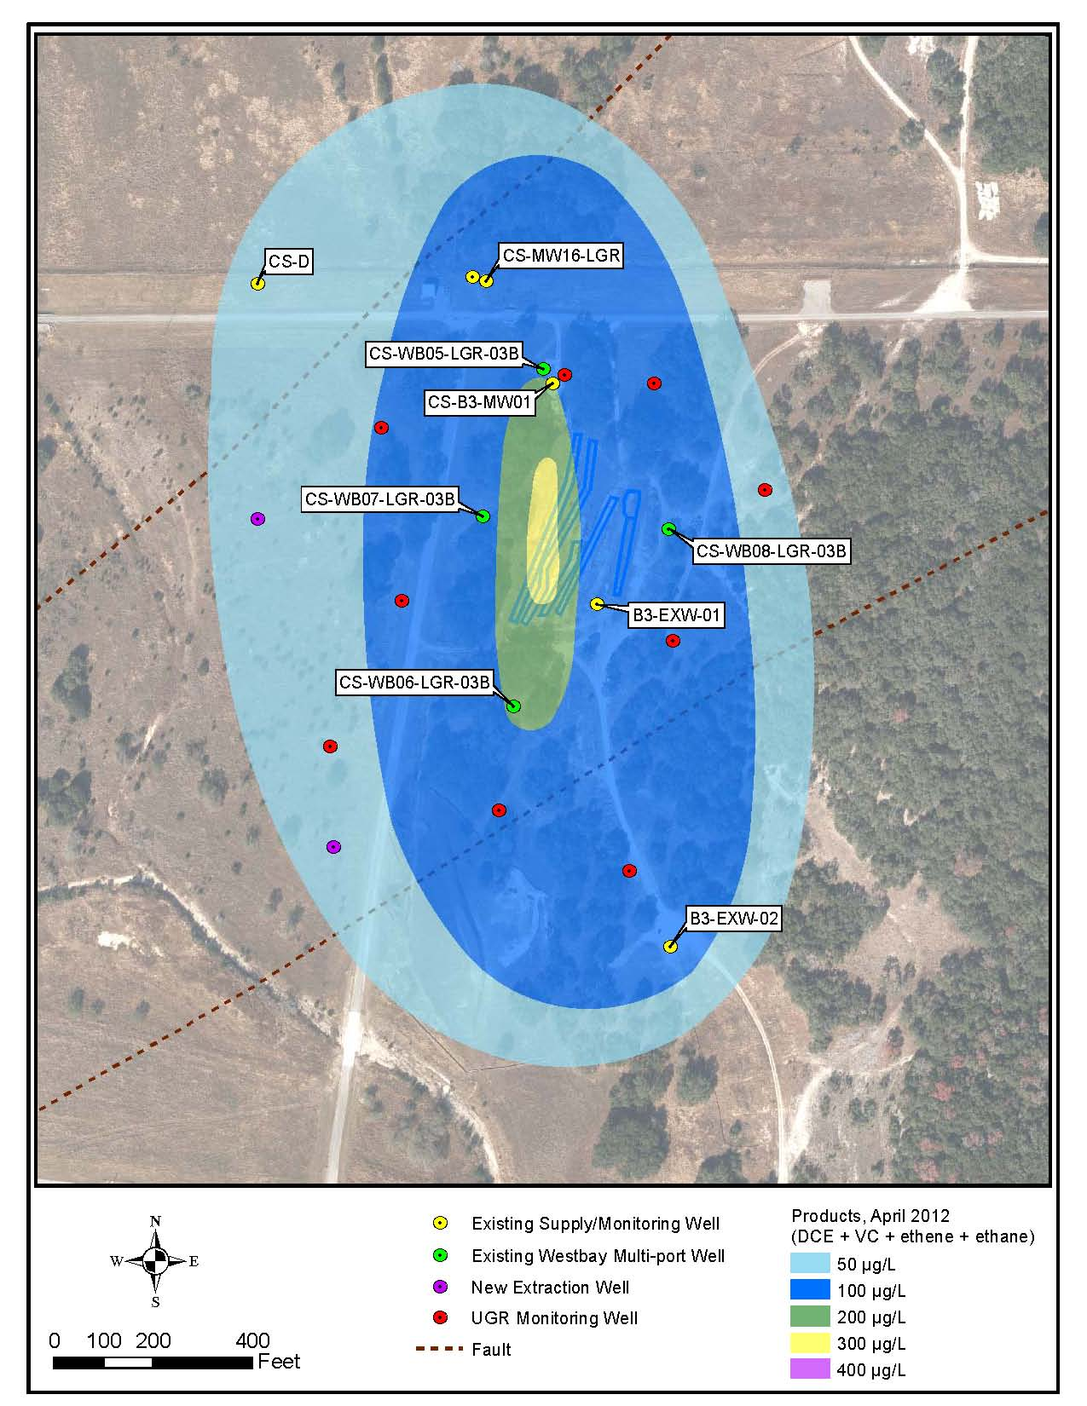
B-3 Bioreactor
LGR Observations – Dechlorination Products
      Moderate to low concentrations of cis-DCE are pervasive across the site.
      Vinyl chloride is detected at WB05 in LGR-03B, LGR-04A and LGR-04B zones, and LGR-CS-B3-MW01 (25, 49, 220, and 209 µg/L, respectively), possibly due to lactate injection activities.
April 2011
April 2012

Slide 42
SWMU B-3
Bioreactor
Next Steps
      Continue monitoring bioreactor.
      Update bioreactor injection and control systems.
      Recharge remaining trenches with additional mulch/gravel mixture and install new injection lines.
      Connect new LGR extraction well to the system (B3-EXW-05; east of bioreactor).

Slide 43
SWMU B-3 and AOC-65
Description
SWMU B-3 Bioreactor:
Enhanced anaerobic bioremediation of chlorinated hydrocarbons in underlying fractured limestone at Plume 1.
AOC-65 Soil Vapor Extraction and Interim Removal Action:
Removal of chlorinated hydrocarbons in underlying fractured limestone at Plume 2.
PCE, March 2012

Slide 44
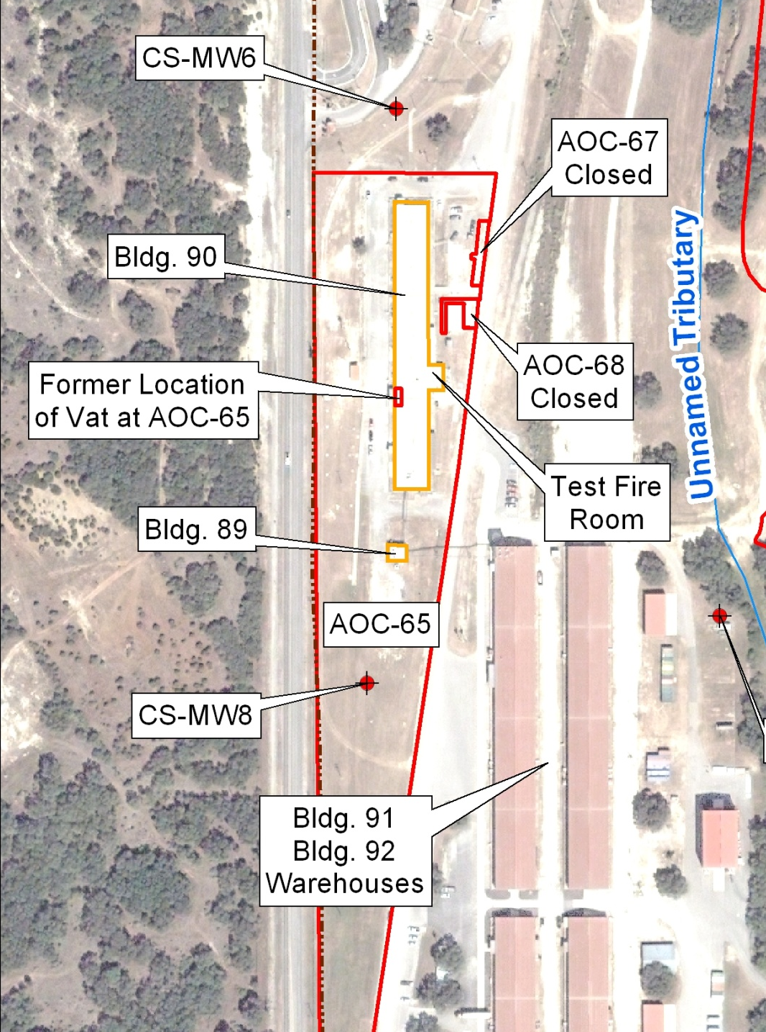
AOC-65
Background
      AOC-65 consists of an area surrounding Building 90.
      Chlorinated solvent degreasing units (vats) were removed in 1995.
      Initial investigations identified groundwater plume (2) in 1999.
      Interim Removal Actions in 2001 excavated and disposed of ~1,300 CY of impacted soil media off-post.
      SVE Pilot Study initiated in 2002, which continues to operate within Permit By Rule Limits.

Slide 45
AOC-65 Treatability Study
Activities since January 2012 :
Excavated trench (as IRA) along drainage ditch west of Building 90.
Performed fracture analysis on IRA trench walls.
Constructed infiltration gallery for ISCO application within IRA trench.
Conducted bench-scale testing for ISCO treatability study.
Performed Sulfur Hexafluoride tracer test.
Installed 7 treatability study wells for ISCO monitoring.

Slide 46
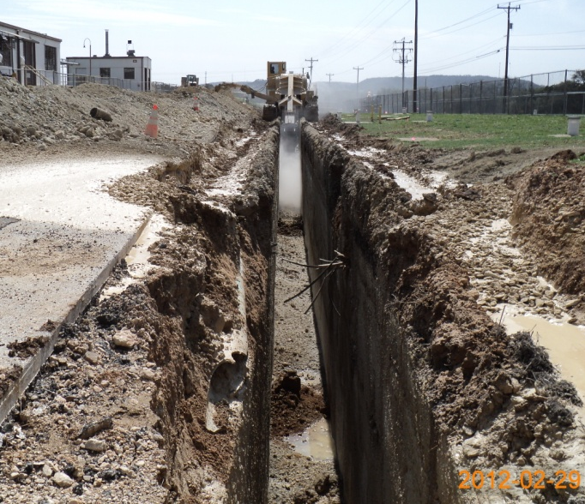
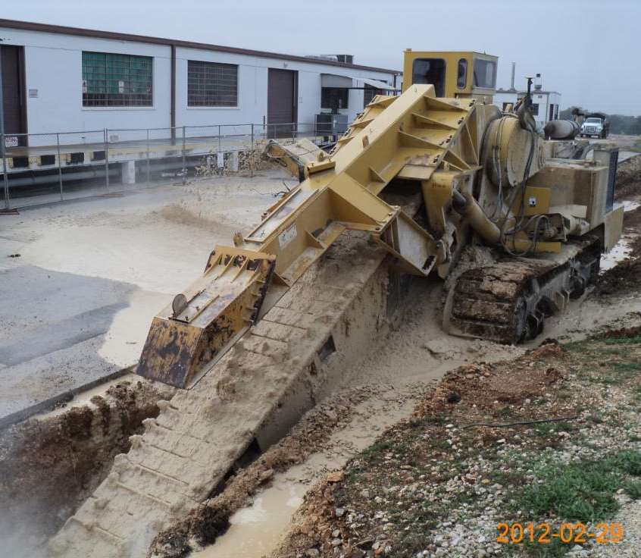
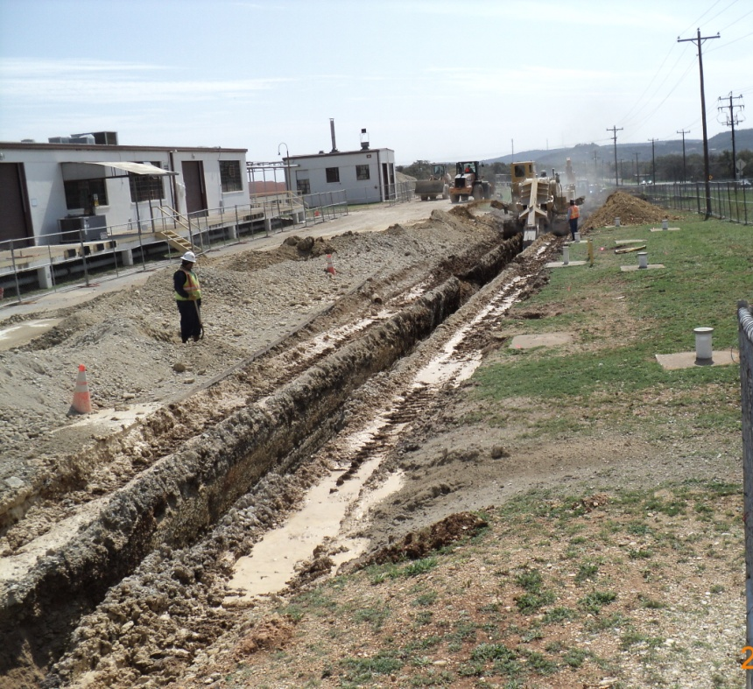
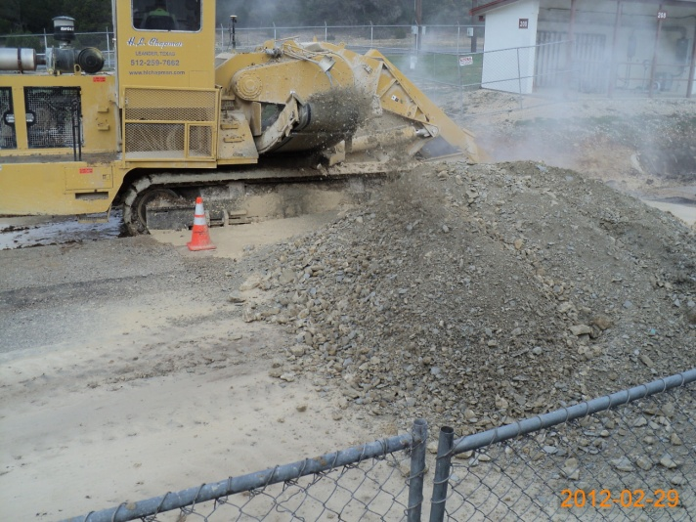
AOC-65 Interim Removal Action
The IRA consisted of excavating a trench ~310 ft. long, ~3.5 ft. wide, and ~15 ft. deep.
Approximately 1,000 CY of materials were removed.
Sampling data indicated the presence of PCE in concentrations as high as 0.32 mg/kg in removed soils.
Characterization data indicated soils met Class 3 waste criteria.

Slide 47
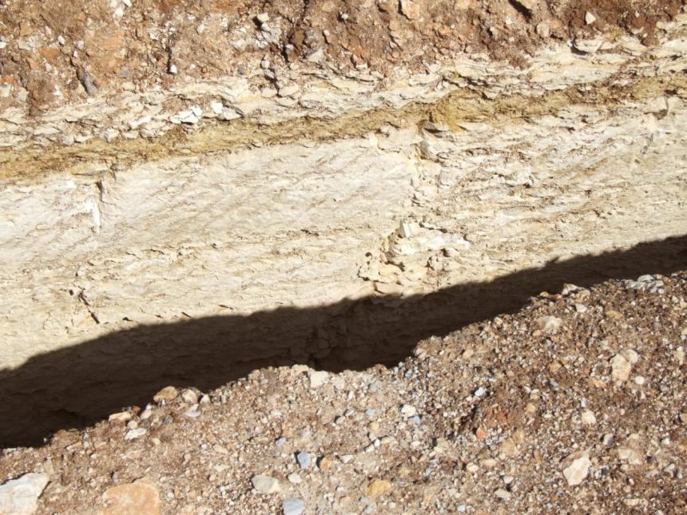
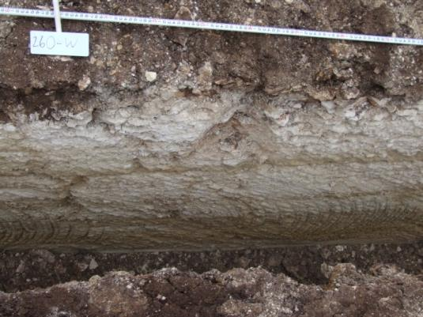
AOC-65 IRA Fracture Analysis
Objective:
  Determine vertical location of fractures within the trench to maximize exposure during ISCO application and construct infiltration gallery accordingly.
  Determine fracture trends to best position Treatability Study Wells (TSWs) to intercept pathways treated with ISCO.
Photo Documentation
  Trench walls were photographed
  Visible fractures were sketched in profiles
  Fractures were matched across the trench
  Fracture trends plotted

Slide 48


AOC-65 IRA
Fracture Analysis (cont.)
TSW locations based on likely locations for fracture intersection.
N76E
Fracture trends based on photo analysis.
Trench mean fracture trend: N78E
N49E
N28E
N65E
N38E
N71E
Rose diagram of 16 paired trench wall fractures.
Mean fracture trend:
(red line): N78.2E
USGS mapped faults

Slide 49

Treatability Study Well (TSW) Installation
      7 TSWs have been installed to improve the groundwater monitoring network within AOC-65.
      TSWs will be monitoring points during the ISCO treatability study.
      TSW locations are generally based on results from trench wall fracture analyses.
      6 TSWs are ~40’ deep with 30’ of screen. One TSW is ~50’ deep with 30’ screen.

Slide 50

ISCO Infiltration Gallery Construction
Each zone is comprised of ½” -sized quartz gravel and includes a 2” perforated HDPE line that runs the length of the trench and is separated from adjacent zones by a 1-foot thick layer of compacted clay.
Note: ISCO material will also be injected at SIW-01, located in the former vat location within Bldg. 90.
19
19

Slide 51





ISCO Infiltration Gallery Construction (cont.)
Gravel added and leveled.
Injection lines installed.
The perforated HDPE injection lines terminate at the northern portion of the trench where they will be connected to tanks for oxidant and activator delivery.
Injection headers installed.
Clay layer added and compacted.

Slide 52

Sulfur Hexafluoride (SF6) Tracer Test
AOC-65 Profile View

Slide 53
Sulfur Hexafluoride (SF₆) Tracer Test
Objective
      Determine the effectiveness of the monitoring network and zone of influence of proposed ISCO application sites.
      Tests performed at SIW-01 and the Middle and Upper infiltration galleries.
      Note: Building 90 has been unoccupied since October 2011, thus there is no VI risk.
Insert graphs of T. tests
Deep
Shallow
Exterior
Sub-Slab

Slide 54


Sulfur Hexafluoride (SF₆) Tracer Test
Results
      The SIW-01 SF₆ injections indicate that the area beneath Building 90 and area east of the trench will require ISCO injections in SIW-01 to affect these areas.
      Injection of SF₆ in the middle infiltration gallery are expected affect areas west of the trench (both shallow and deep.
      Anticipate injection of ISCO chemical in all zones of the trench and SIW-01.
SIW-01
~170 cu. ft SF₆ applied within middle gallery
~10 cu. ft SF₆ applied within SIW-01
SF₆ concentration (ppm)
SF₆ concentration (ppm)

Slide 55
ISCO Bench-Scale Test
Objective: Determine ISCO oxidant and activator dosage requirements and determine potential for metals mobility.
Core samples of correlative materials were sent to FMC Environmental solutions for Klozur Demand Testing (KDT).
Based on the results of the KDT tests FMC recommends the use of:
  10 to 20% Klozur solution
  activated with 25% NaOH solution
Oxidant ( Klozur persulfate) |  | Activator (25% NaOH)
dry weight (lbs) | 19,800 | Acid Neutralization Demand [(12.7 gallons per 100 lbs Klz)] (gallons) | 2,514.6
20% solution [(1.9 lbs Klz/gal)] (gallons) | 10,421 | Soil Buffering Capacity [30% Acid neutralization demand] (gallons) | 754.4
Total 20% Klozur persulfate required (gallons) | 10,421 | Total 25% NaOH demand (gallons) | 3,269
Dosage requirement (20% Klz/25% NaOH) = 3.19 : 1 (volume)
Klozur Demand Test Results
Persulfate Demand (48-hour exposure) | Persulfate Demand (96-hour exposure)
0.418 g/kg | 0.555 g/kg
Average Soil Oxidant Demand (SOD) | 0.49 g/kg

Slide 56
ISCO Bench-Scale Test
Results (cont.)
The oxidation process will mobilize metals due to changes in pH.
Areas outside the treatment zone will not likely be affected as the metals are expected to precipitate out as the pH returns to a more neutral state.
Metals monitoring will be included in the ISCO sampling plan for both on and off-post monitoring points.
 | Non-Exposed Core |  | Core after 96-hr Exposure Period |  | ISCO Solution following 96-hr Exposure
Analyte | Concentration (mg/kg) | Flag | Concentration (mg/kg) | Flag | Concentration (mg/L) | Flag
Arsenic | 3.1 | F | 2.7 | F | 26.23
Barium | 3.3 |  | 2.4 |  | 47.84
Cadmium | ND | U | ND | U | ND | U
Chromium | 3.4 | F | 2.9 | F | 39.38
Copper | 6.53 |  | 8.04 |  | 45.3
Lead | 0.85 | F | ND | U | 21.61
Nickel | 5.64 |  | 4.09 |  | 31.13
Zinc | 3.7 | F | 3.5 | F | 58.55
Mercury | ND |  | ND | U | 0.0014 | F

Slide 57

AOC-65 ISCO Treatability Study
Next Steps
A UIC permit has been obtained for the injection of Sodium Persulfate and Sodium Hydroxide. TCEQ Authorization No. 5X2600645
Letters to GAC well owners have been sent describing ISCO injection activities and anticipated additional sampling efforts.

Slide 58
AOC-65 Treatability Study
Next Steps (Cont.)
Continue monitoring SVE system to determine effectiveness of treating source area.
Relocate Eastern system blowers inside Building 90.
Engineer/install protection measures around operating Sub-Slab VEWs prior to Building 90 renovation efforts.
Plug and abandon unused Sub-Slab VEWs prior to renovations.
Expand SCADA control panels to accommodate flow meter instrumentation.
Perform ISCO treatability study utilizing Klozur sodium persulfate activated with sodium hydroxide.
  Application of oxidant and activator within all zones of infiltration gallery and SIW-01.
  Sample collection 1, 5, 15, and 30 days after ISCO application at on-post and off post GAC wells.
    Analyses: VOCs and EPA Priority Metals
    Field Parameter collection: Water level and pH as well as field collected metals (via XRF)
  Sample collection for field and laboratory analysis is expected to continue on a monthly basis at selected on-post and off-post well.
Prepare ISCO Treatability Study Report

Slide 59
Closure Path for EPA Order

Slide 60
3008(H) Order Timeline
720 days
60 days
Implement
O&M
and
Long Term
Monitoring
Submit
RFI/CMS*
Report
Submit
HH/Eco
Risk
Assessment
Submit
CMI
Program
Plan
Implement
Decision
Document
120 days
Approve
RFI
Work Plan
Approve
RFI/CMS
Report
Implement
Corrective
Action
Prepare
Statement
of Basis
Hold Public
Meeting on
Statement
of Basis
Prepare
Decision
Document
* The CMS Report is due 120 days after the RFI Report is submitted. However, CSSA plans to submit them concurrently.

Slide 61
Associated Closure Documents/Steps
RCRA Facility Investigation Report
Corrective Measures Study
Human Health and Ecological Risk Assessment
Corrective Measures Implementation Program Plan
Implement Corrective Action
Statement of Basis
Public Meeting
Decision Document
Others? (LUCs, Periodic Reviews)

Slide 62
Funding, Budget, and Program Status
Gabe’s Slides

Slide 63
2012 Budget to Date

Slide 64
2012 Budget to Date

Slide 65
Site Status

Slide 66
Site Status FY11 – FY12

Slide 67
Site Closure

Slide 68
Site Closure

